Slide 1
Natural Language Processing

Slide 2

What is NLP?
Study of interaction between computers and human languages
NLP = linguistics + computer science + AI

Slide 3

Common nlp tasks
Chunking
Part-of-Speech tagging
Named Entity Recognition
Spam Detection
Thesaurus
Syntactic Parsing
Word Sense Disambiguation
Sentiment Analysis
Topic Modelling
Information Retrieval
Machine Translation
Text Generation
Automatic Summarization
Question Answering
Conversational Interfaces

Slide 4



Why is it difficult?
Non-standard language
Ambiguity
Language complexity itself!

Slide 5
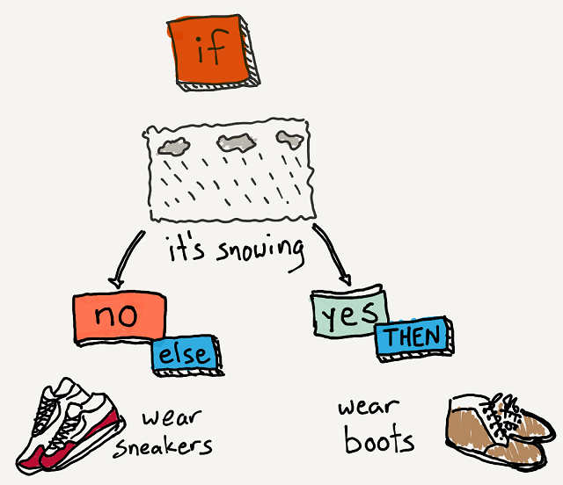

How to tackle it?
Rather than ifelse statements, let the data speak for itself!

Slide 6
Classical nlp pipeline
tokenization
When a string is split in a meaningful unit of text (such as a word or n-gram)
stop words
Common words that carry little (or perhaps no) meaningful information
stemming
The process of identifying the base word (or stem) for a dataset of words
word embeddings
A way to represent text data as vectors of numbers based on a huge corpus of text

Slide 7
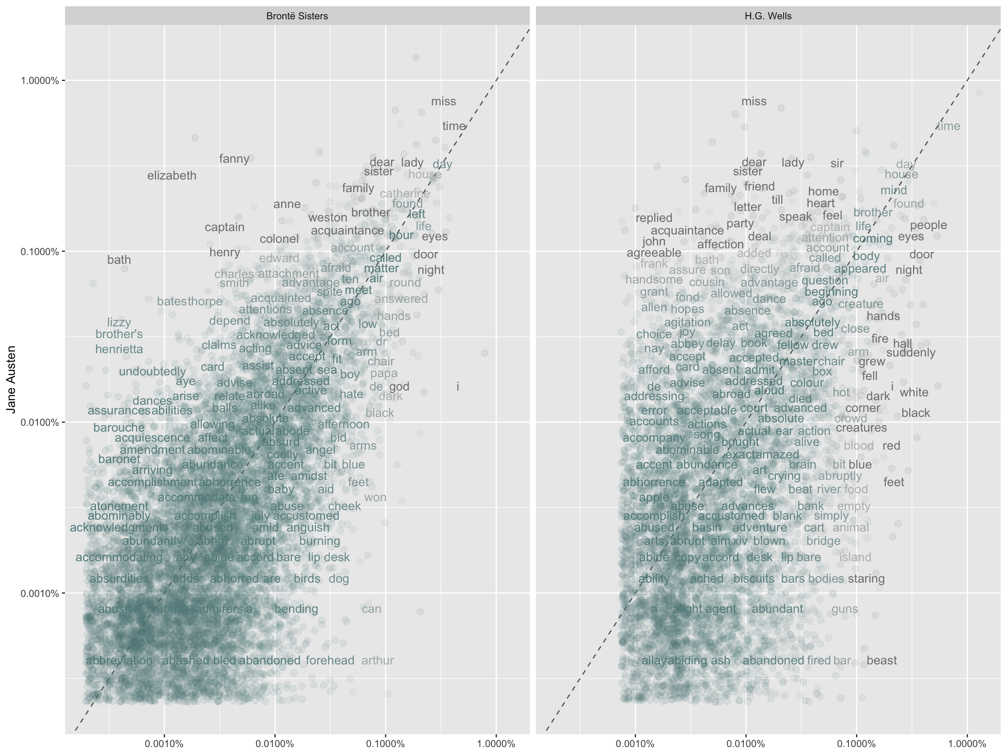



Word frequencies
A common task in text mining is to look at word frequencies
Using this we can see difference for distinct authors!

Slide 8
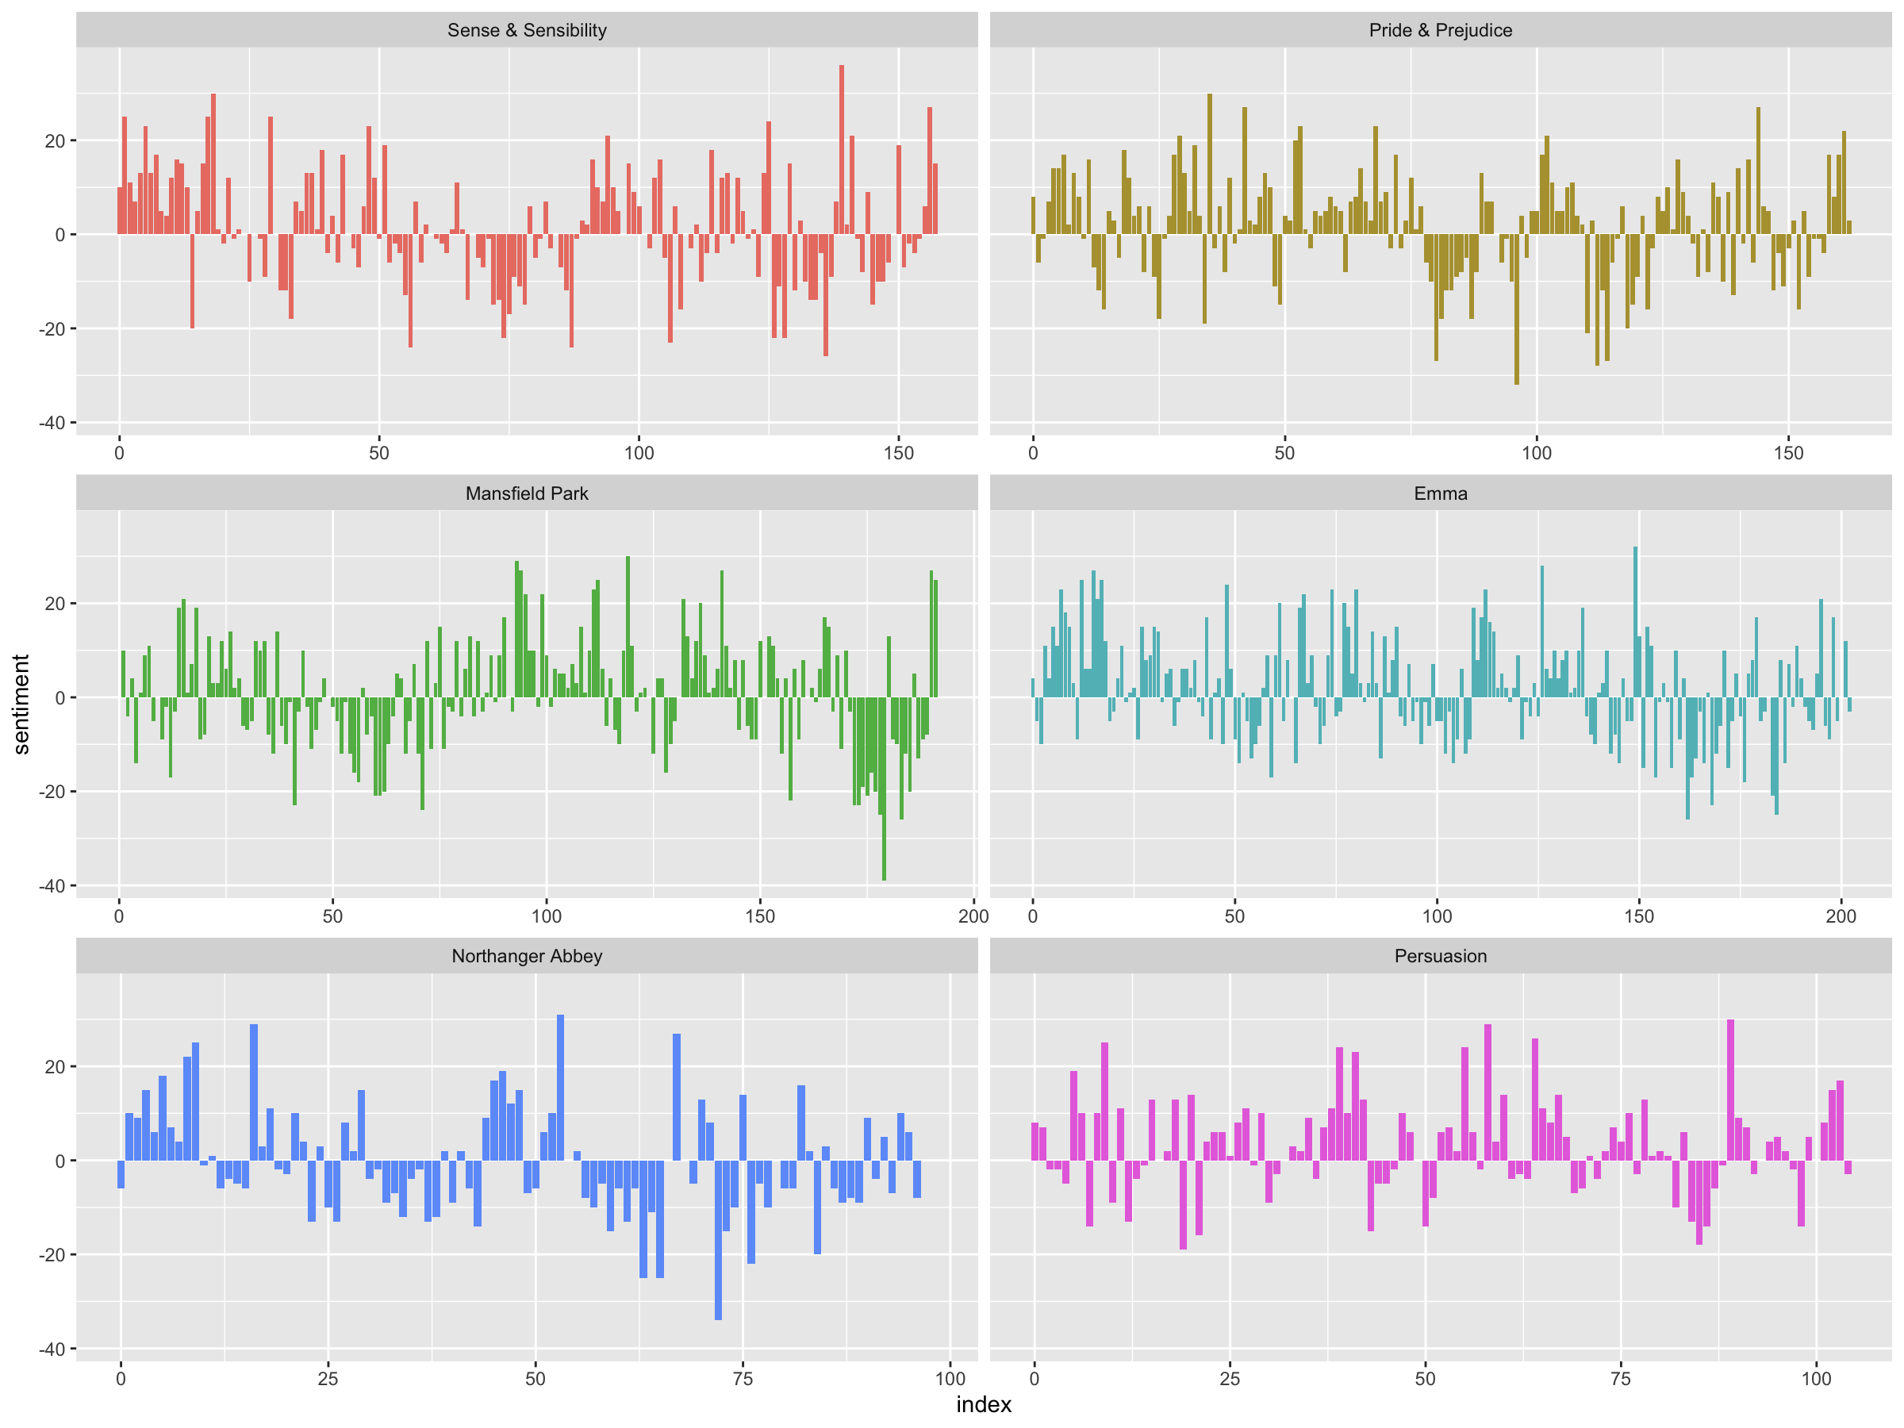

SENTIMENT ANALYSIS
Dictionary-based methods
Sentiment of a text is the sum of the sentiment content of the individual words (sentiment lexicons)

Slide 9
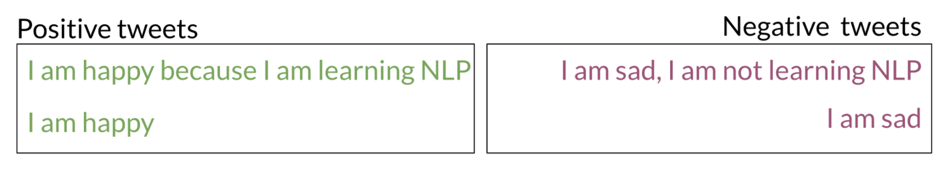
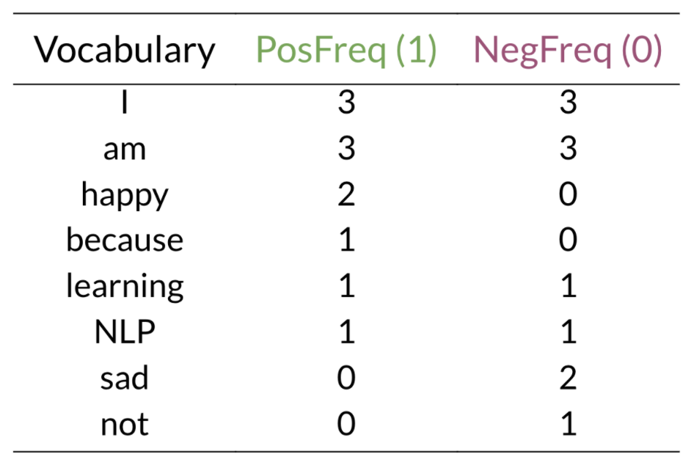
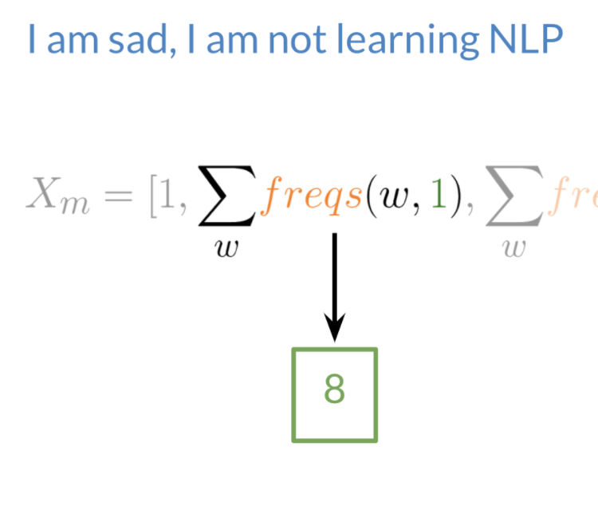
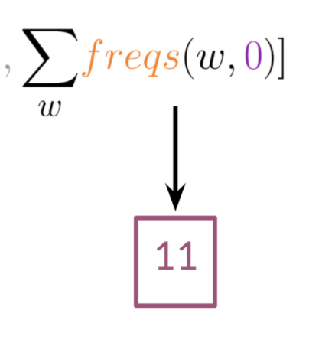
Sentiment analysis (cont.)

Slide 10
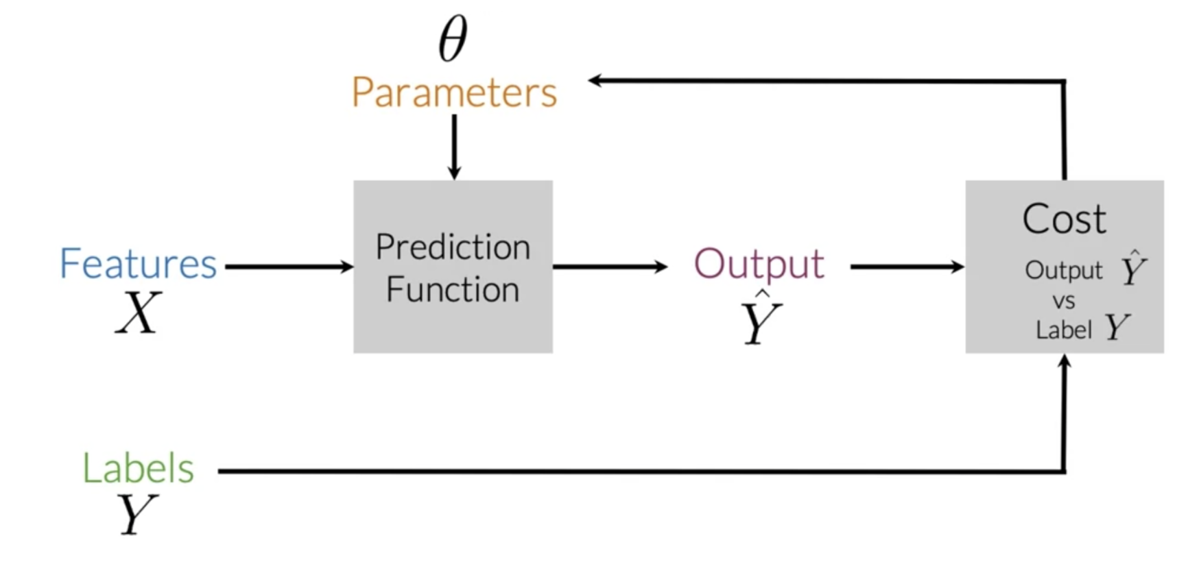
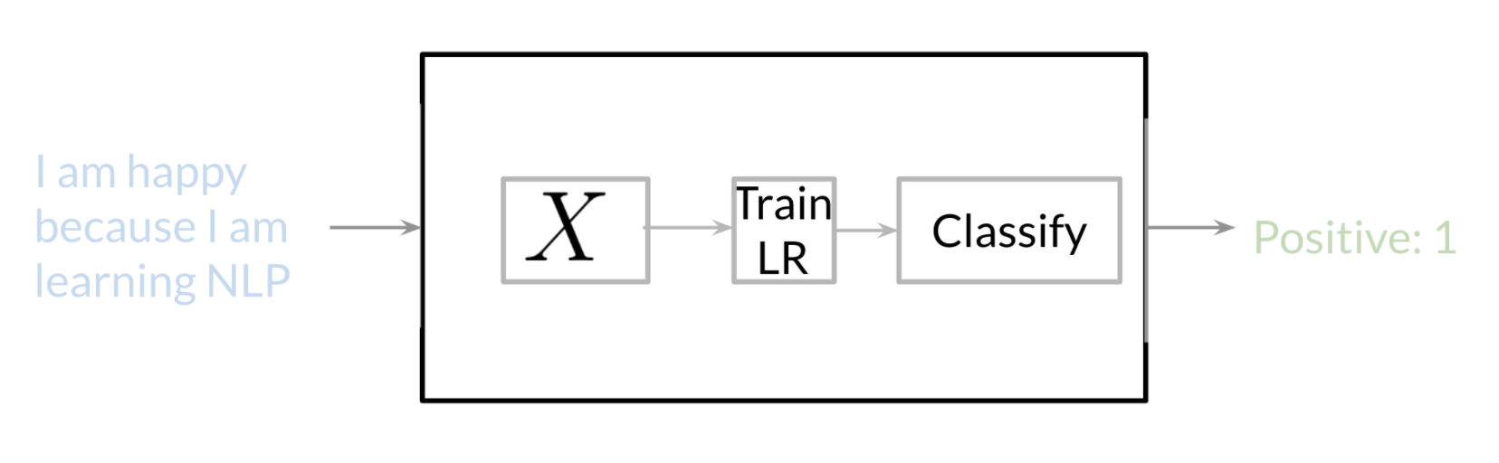
Sentiment analysis (cont.)

Slide 11
LINKS
https://www.tidytextmining.com/index.html
https://smltar.com/
https://juliasilge.com/blog/
https://www.coursera.org/learn/classification-vector-spaces-in-nlp
https://bradleyboehmke.github.io/HOML/

